Slide 1
READING
difficulties
and
disabilities

Slide 3
Reading Retardation
“
…a backwardness in reading that can be corrected by special instruction.
- Dallman and De Boer, 1978
Notes:
A child is retarded if he reads well below grade level but has the capacity to perform at a higher level. Capacity for learning to read is measured by intelligence tests.

Slide 4
Types of Retarded Readers
One who is not reading as well as he can but is able to improve his performance under the guidance of the regular classroom teacher.
One who has difficulties which are serious enough to require the assistance of a remedial teacher, usually in a special reading class.
One who fails to make progress in reading, in spite of the persistent efforts by the school to help him and who needs the attention of specialists.
Notes:
Specialists…
Who are skilled in investigating causes that interfere with the progress of reading.

Slide 5
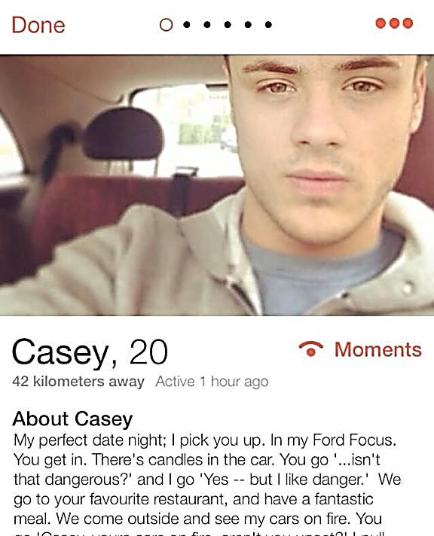
Harris, 1971
Retarded Reader
It refers to any individual whose development reading skills is below the normal performance for his age or grade. It includes poor reading; limited reading skills; slow mental development; potential capacity to do better.
Notes:
The retarded reader whose achievement in reading is significantly below the normal expectancy for his abilities is said to be a case of reading disability.

Slide 6
“
Children with complex disabilities are disabled readers whose problems are more subtle and complicated.
- Bond and Tinker, 1971
Notes:
They are usually bright, capable youngsters who demonstrate antagonism (active hostility or opposition. synonyms: bad blood) toward reading and who feel embarrassed about their inability to read. Most often, they exhibit a lack of persistence and tendency to retreat from school; hence becoming delinquent.
What are some other manifestations of affective filters?

Slide 7
Fear
Anxiety
“I don’t like reading,
Worry
tologo.”
Notes:
A child with complex disability is often found to have anxiety, fear, and worry about reading. He feels insecure and defeated. He needs clinical diagnosis and guidance from a team of specialists who would be able to appraise his needs accurately and thoroughly.

Slide 8
D | I | S | A | B | I | L | I | T | Y | T | G | I | O | N | S
K | R | I | S | D | S | I | S | O | N | G | A | I | D | O | T
U | N | O | I | S | N | E | H | E | R | P | M | O | C | I | R
T | B | R | E | T | A | R | D | A | T | I | O | N | O | T | A
R | E | Y | C | N | E | I | C | I | F | E | D | B | R | A | T
E | H | U | E | S | W | T | H | T | R | Y | R | R | E | V | E
H | I | G | H | E | R | O | R | D | E | R | U | E | D | I | G
R | U | D | Y | S | L | E | X | I | A | E | M | A | A | T | I
A | O | R | D | G | G | B | O | O | D | I | M | T | E | O | E
O | R | A | L | F | L | U | E | N | C | Y | R | H | R | M | S
CHOOSE
WHAT OTHER TERMS DO YOU SEE IN THE TABLE?
Notes:
Get hold with these terms because we will be encountering some of them soon.

Slide 9
Reading Deficiency
“
A mild to severe retardation in learning to read which is disparate with individual’s general intelligence and with his cultural, linguistic, and educational experience.

Slide 10
Reading Retardation
“
Originally used to designate the condition of all children whose reading was significantly below age and grade norm, regardless of the children’s potential or intelligence

Slide 11
Primary Reading Retardation
A sense of impairment of capacity to learn.
Secondary Reading Retardation
A reading disability for which the causation is mainly environmental or external
“Brain injury with reading retardation”
Proposed by Rabinovitch (1978)
Notes:
Primary Reading Retardation:
Although there is no brain damage, this is based on a constitutional patter of disturbed neurological organization.

Slide 12
Retarded Reader
One whose reading achievement is less than that of his peer group. One who is behind the normal or expected pattern of achievement.
Notes:
To be retarded means to be behind or to be delayed in arriving. This includes all individuals who have achieved less than normal.

Slide 13
Reading Disability
“
Refers to retarded readers whose mental ability should enable them to read considerably better than they do.
Notes:
Synonymous to deficiency.

Slide 14
Dyslexia
“
A defective reading which may represent loss of competency following brain injury or degeneration or a development failure to profit from instruction
Notes:
It is often classified into developmental (a general failure in learning) or as specific (in contrast to general learning failure). It denotes severe reading disability in an individual who is free from mental defects, serious primary neurotic traits, and all gross neurological defects. This is of constitutional and not of environmental origin. It is often genetically determined.
It is a term often used by medical specialists to define a subgroup within the group referred to by the term reading disability.

Slide 15
Underachiever in Reading
Restricted to those whose reading performance is not below age and grade standards but who are judged to be functioning significantly below their own potential level in reading
Slow Learner
Reluctant Reader
Disadvantaged Reader
Retarded Reader

Slide 16
Slow Reader
Ability level with an IQ below 90
Seldom reads on ability level
Generally reads below grade level
Instruction needs to be adapted to his limited ability
The pace of instructions and teacher expectations must be realistic

Slide 17
Reluctant Reader
Can read but will not
The root of reading difficulties is the mental attitude of the pupil
Solutions to the reading problem begins with a change of attitude

Slide 18
Disadvantaged Reader
Potential often far exceeds performance
Generally can learn and wants to learn
Lacks adequate oral language because of inadequate experience
Does not look upon reading as life-related
Often feels alienated from the larger social structure
Often is deficient in auditory attention
Needs to learn how to learn

Slide 19
Retarded Reader
Usually of average or above average intelligence, although could also be a slow reader
Does not read on ability level
May or may not be reading below grade level
May show blocks to learning, especially emotional or neurological, which keep him from learning to read
Instruction needs to be adapted to his limited ability

Slide 20
Targets of Reading Assessment

Slide 21
ORAL FLUENCY
Modified Instructional Plans
Read aloud to students to model effective reading.
Allow students to choose (and practice) text and then read to an audience.
Have students tape record themselves and then listen to their reading.
Use mini-lesson directed toward improving fluency (cloze activity) and over learning word parts.
Repetition is important; allow students to reread and rerecord the same text, with feedback and guidance.
Access or build rich and complete background knowledge prior to and during reading.
Allow students to practice partner reading.
Read drama aloud so students can practice intonation and finding the voices of different characters.
Give students access to a lot of easy-to-read text.
Allow students to practice choral reading.
Indicators of Difficulty:
Reads at a slower pace
Pauses or stops often
Does not attend to punctuation
Sounds unnatural
Reads word for word
Reads with little or no expression
Seems to take more effort to read
Stumbles over multi-syllabic words
Only attends to the beginning of words

Slide 22
COMPREHENSION
Modified Instructional Plans
Access or build rich and complete background knowledge prior to reading.
Allow students to talk about the text they are reading.
Use lots of retell—like dramatization or a written retell— for follow-up activity.
Ask students to use what they know about what they have read.
Ask questions, verbally and in writing, that go beyond factual recall.
Pre-teach important vocabulary words.
Develop analogies, metaphors, and real-world examples.
Read small portions of text and have students discuss text immediately.
Model comprehension strategies.
Indicators of Difficulty:
Gives weak retell: plot, characters, etc.
Selects insignificant details to talk or write about
May not respond to humor in a story
Strives for flawless oral reading performance
Orally reads too quickly
Omits entire phrases without recognizing or self-correcting
Over uses or misuses graphophonic clues: (For example though and through)
Substitutes non-words with many of the same letters as actual words
Disrupts meaning by substituting pronouns
Confuses words that look similar
Has trouble with contractions
Misreads words that do not maintain the author’s meaning without self-correcting

Slide 23
STRATEGIES
Modified Instructional Plans
Teach students to think about strategies before, during, and after reading.
Involve students in generating a comprehensive list of before, during, and after reading strategies.
Post these reading strategies in your room and refer to them often.
Ask students to tell you the strategies they used and when they used them.
Ask students to assess themselves in their use of reading strategies and then set goals for themselves.
Model strategies for your students (Think Aloud).
Before assigning text, consider with the class the purpose for reading, the type of text to be read, and adjustments they may need to make.
Determine what strategies your students are weak in and give mini-lessons on those strategies.
Allow lots of choice. Students are more interested in text they choose and may be more willing to engage in strategies that will help them make meaning.
Model before, during, and after reading strategies.
Indicators of Difficulty:
May use only a tedious “sound out” strategy when running into difﬁculty
Has trouble predicting/conﬁrming
Seems unable to adjust reading in other genres
Is unable to use a name strategy
Has trouble with dialogue carriers
Is unaware that words and phrases mean different things in different contexts
Effectively reads material related to own background but not new concepts
Seeks help outside themselves when comes to difﬁculty
Over uses one or two strategies regardless of difﬁculty

Slide 24
HIGHER ORDER THINKING
Indicators of Difficulty:
Has trouble discussing motivation, values, basis for decisions, and relationships with other characters
May have trouble with point of view
Has trouble inferring—time, place, plot
May not realize that in their experiences with a variety of texts they have developed schema and they need to connect to it
Reads to gain minimal information (correct answer)
Unaware that: Authors have speciﬁc intentions and as readers they are capable of determining them; Readers have the right to disagree with or question the author’s opinion but should have reasons for disagreeing; Authors, including scientists and other authorities, have points of view that are often implicitly rather than explicitly embedded in text; Because something appears in print does not mean it is true
No evidence of: Predicting, Questioning, Clarifying, Summarizing, Connecting, Evaluating
Modified Instructional Plans
Teach students to think about strategies before, during, and after reading.
Involve students in generating a comprehensive list of before, during, and after reading strategies.
Post these reading strategies in your room and refer to them often.
Ask students to tell you the strategies they used and when they used them.
Ask students to assess themselves in their use of reading strategies and then set goals for themselves.
Model strategies for your students (Think Aloud).
Before assigning text, consider with the class the purpose for reading, the type of text to be read, and adjustments they may need to make.
Determine what strategies your students are weak in and give mini-lessons on those strategies.
Allow lots of choice. Students are more interested in text they choose and may be more willing to engage in strategies that will help them make meaning.
Model before, during, and after reading strategies.

Slide 25
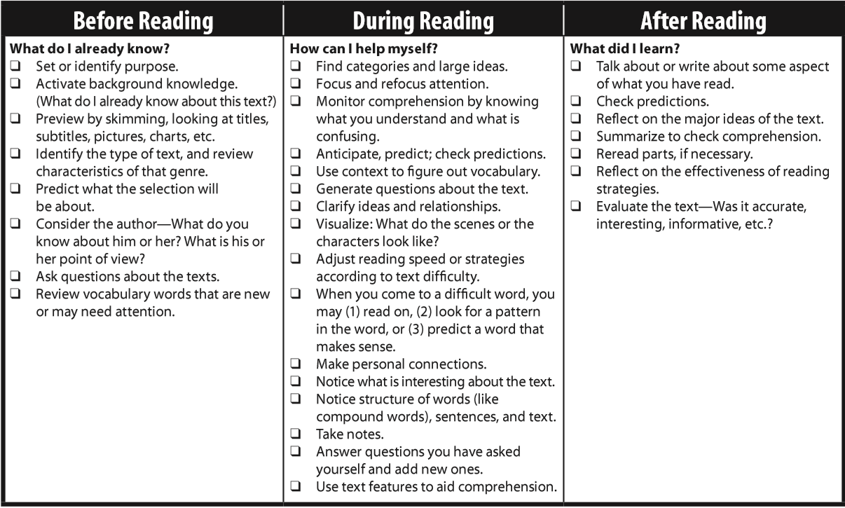

Slide 26
MOTIVATION
Indicators of Difficulty:
Reluctant to choose own reading materials
Dislikes long books
Extrinsic reader
Likes to read for correct answers
Rarely reads during free time
Reads only one kind of material
Modified Instructional Plans
Give students lots of choice in what they read.
Allow students to talk informally about what they have read.
Allow students to socialize, discuss, work together on projects related to their reading, etc.
Allow students to bring in and share text they have read and enjoyed.
Build a risk-free environment.
Model your own motivation for reading and model reading yourself.
Provide lots and lots of materials with different reading levels, different genres, and different content areas.
Administer an interest inventory and gather appropriate reading materials.

Slide 27
Implication. Values integration.
Notes:
REVIEW OF WHAT WAS LEARNED:

